Slide 1
Common Emitter Amplifier
by:
Cole Bailey (SID: 014346785)
Paco Ellaga (SID: 009602331)
Jahaira Lucas (SID: 013989155)
Donovan Minto (SID: 013881580)

Slide 2
Objective
Design an NPN configured Common Emitter (CE) Amplifier
Determine the results of the following:
Mid - frequency gain, A_{MID-FREQ},
Low frequency poles, F_{L},
High frequency poles, F_{H},
Understand real-world applications of the CE Amplifier

Slide 3
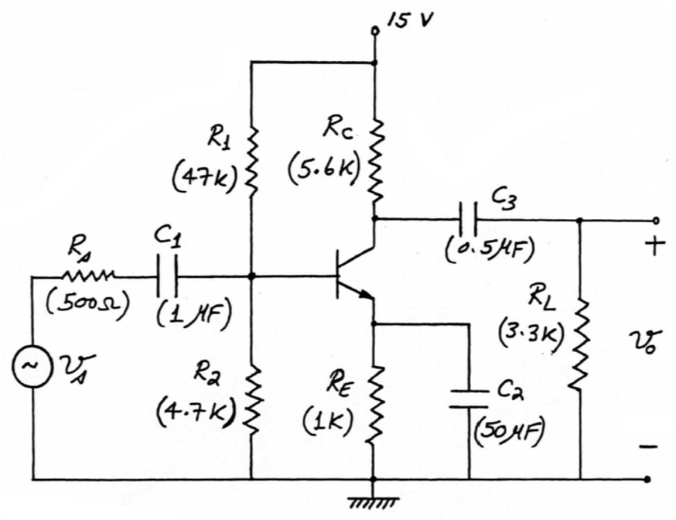
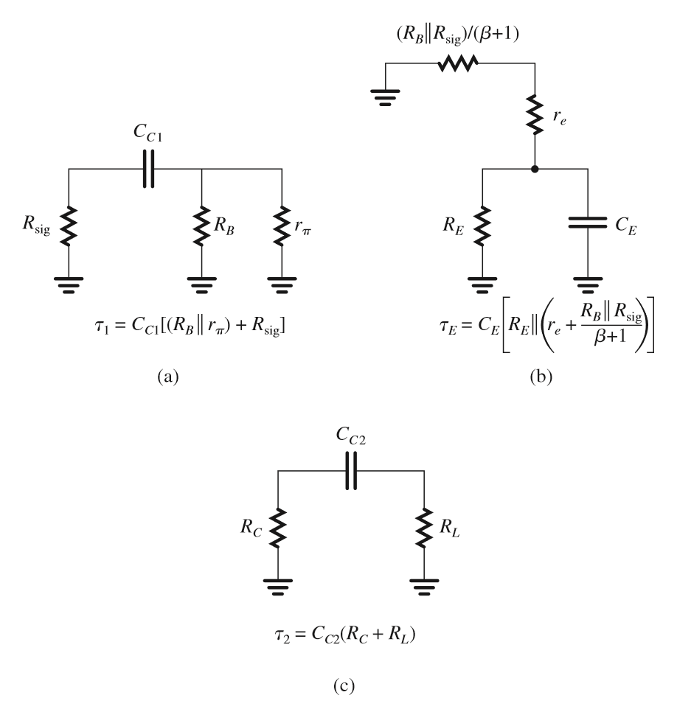
Design & Characteristic Results
Coupling Capacitors
C1 and C3 blocks DC
Bypass Capacitor
RE increases gain in the circuits midband frequencies
Decreases bandwidth (shown in images)
Use T-model of the BJT to create an equivalent circuit
Set Vin = 0 to get 3 individual circuits to find the time constants of each capacitor

Slide 4
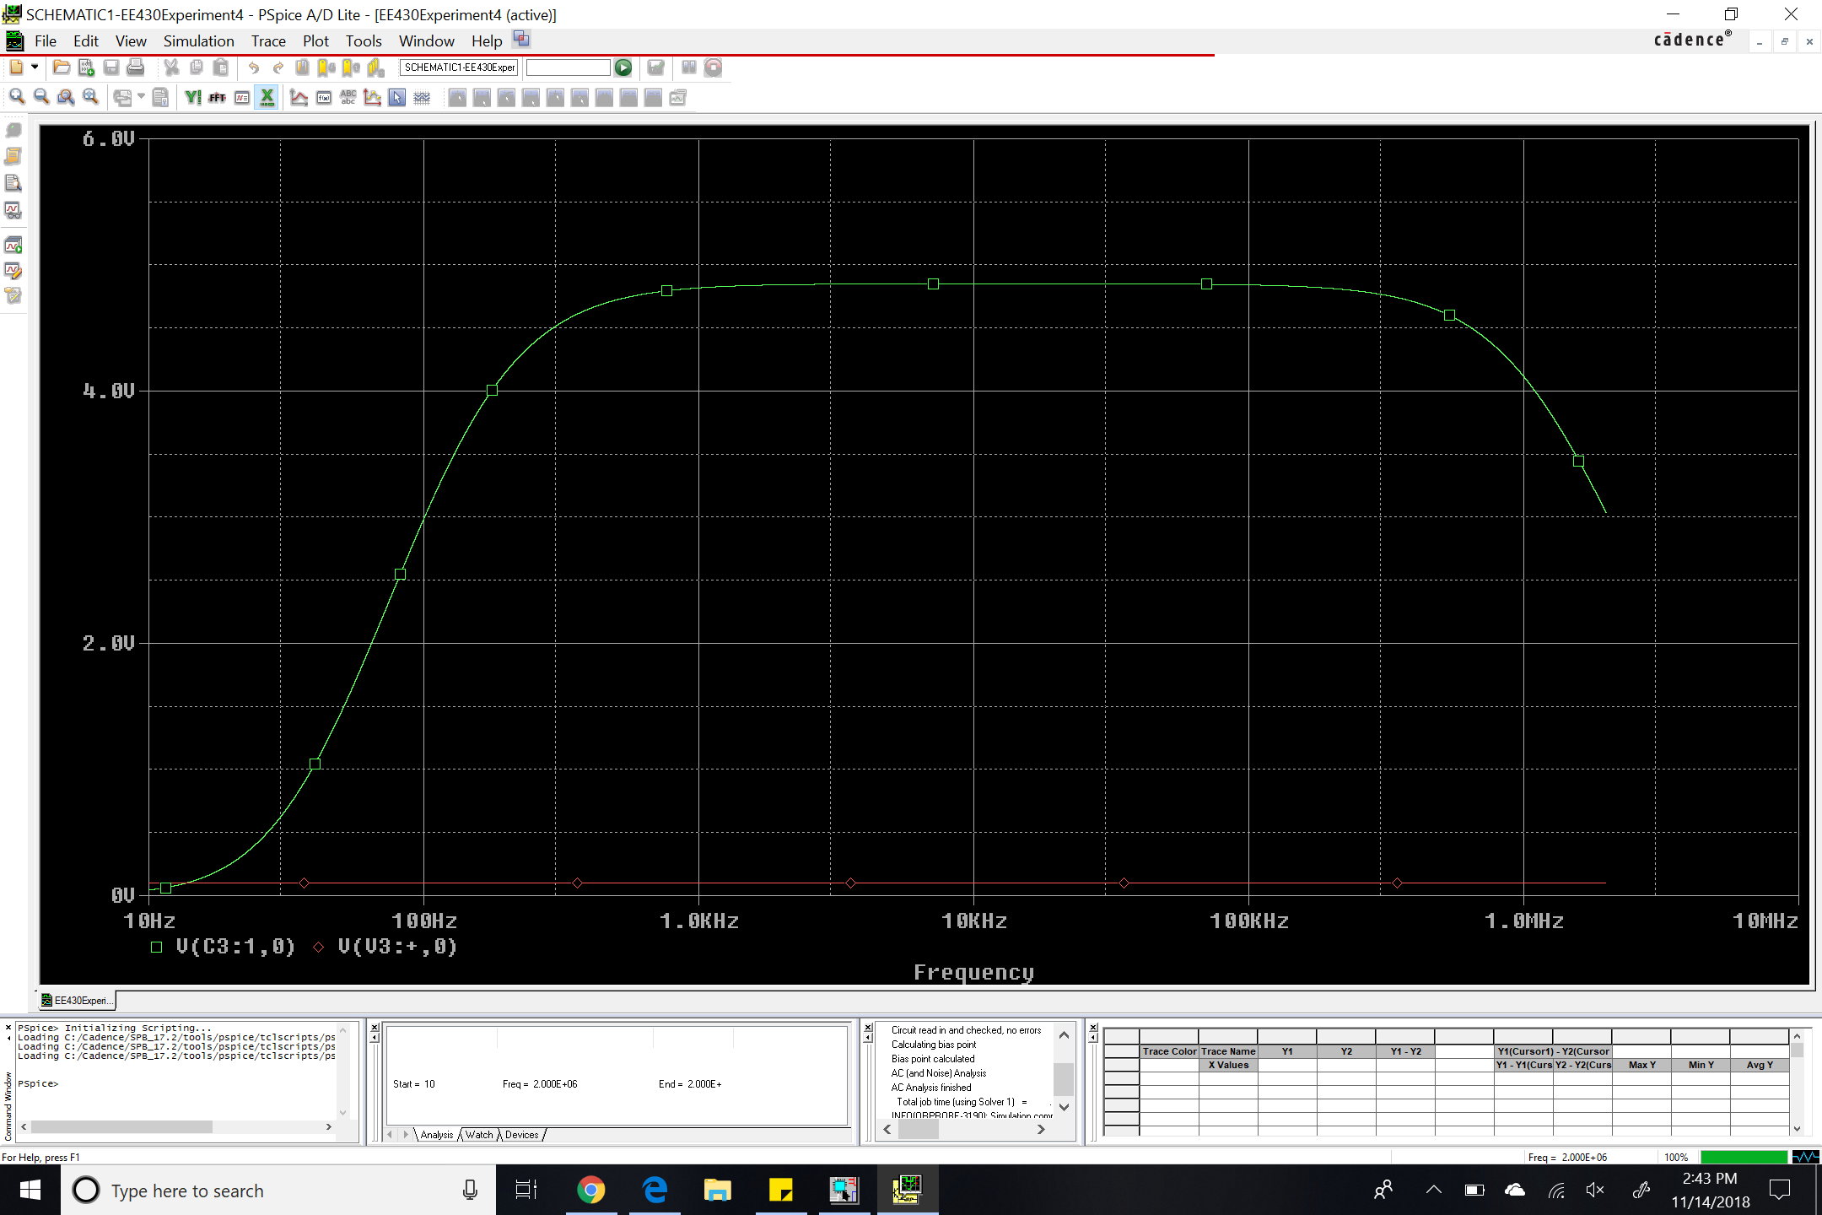
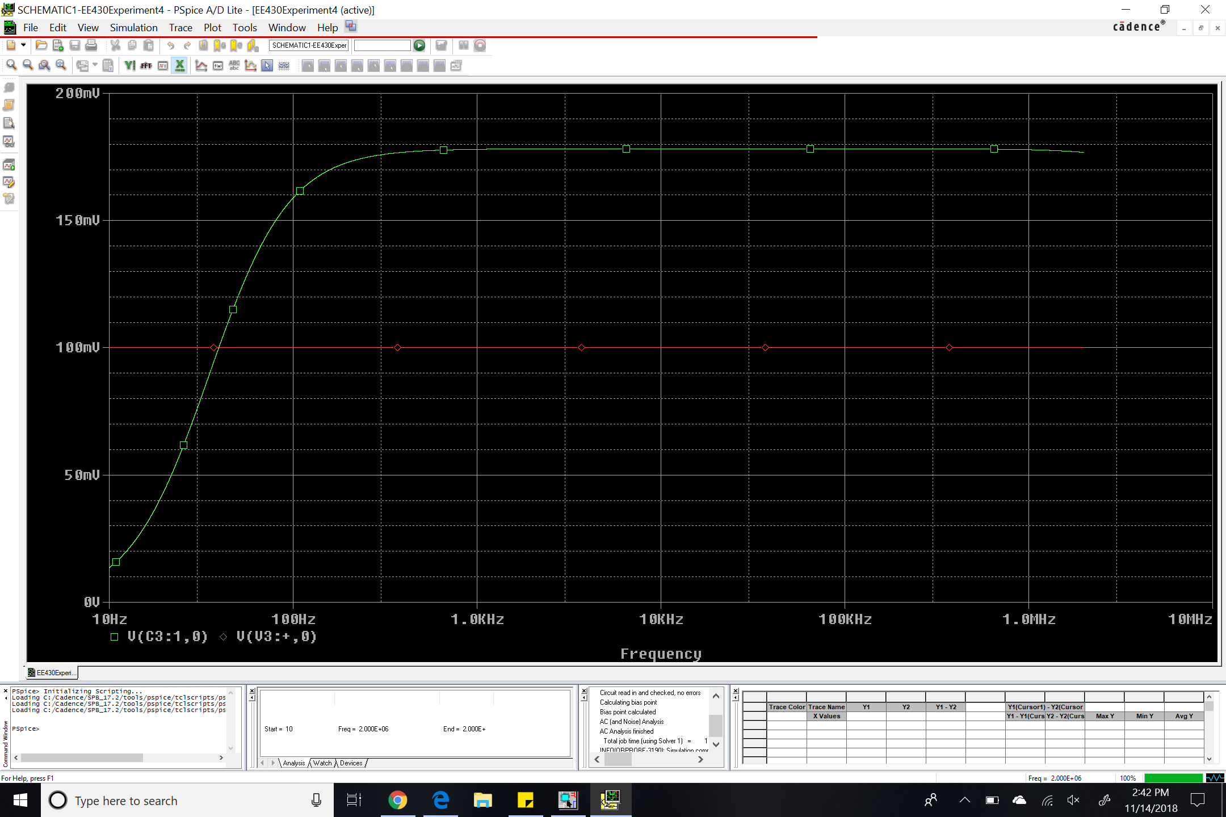
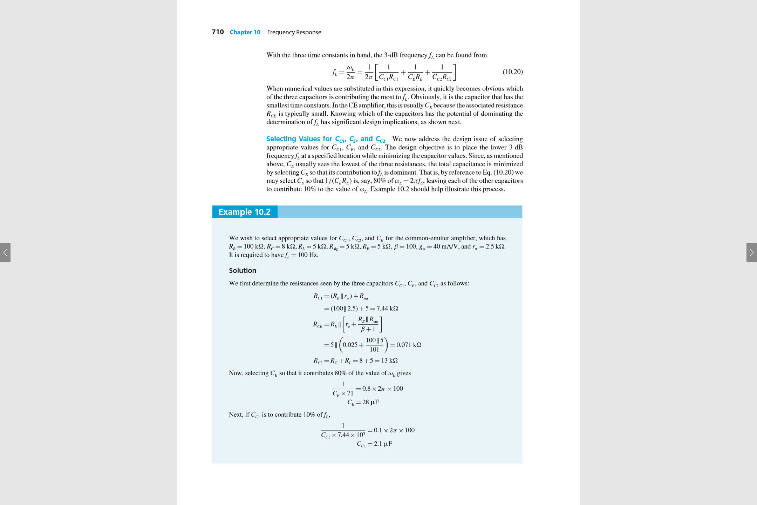
Design & Characteristic Results
Low Frequency poles = inverse of capacitor time constants
Image 1: Frequency response of the CE Amplifier with the bypass capacitor
Gain = 41 V/V
Lower 3dB cutoff frequency = 225 Hz
Upper 3dB cutoff frequency = .93 MHz
Image 2: Frequency response after removing the bypass capacitor
Gain = 1.8 V/V
Lower 3dB cutoff frequency = 100 Hz
Upper 3dB cutoff frequency = 3.5 MHz
fH = 1 / (2π*C_{in}*R’_{SIG} )

Slide 5
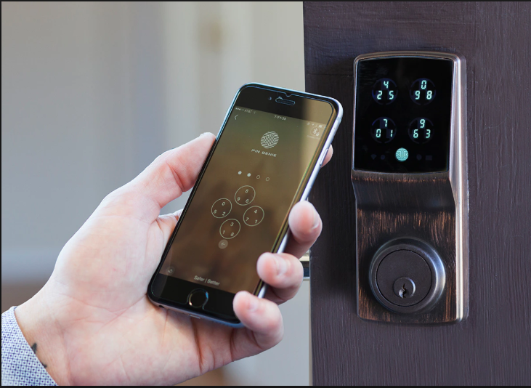
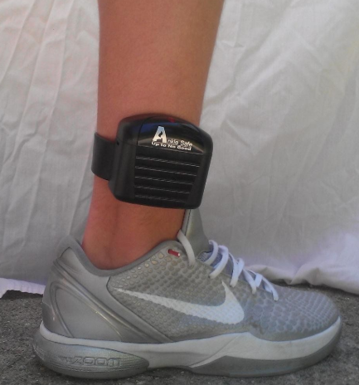
Application #1
RF modules
Transmitter, receiver, transceiver, and System on a Chip (SoC)
Electronic wireless communication systems
Monitoring systems
Can be used in city and county law enforcement
Able to track defendants through ankle bracelet and a monitoring base station
Smart-Technology Devices
Smart door locks
Bluetooth trackers
Home audio systems

Slide 6
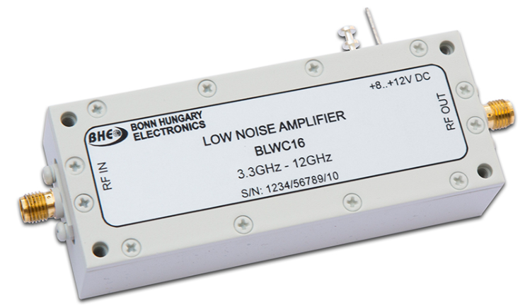
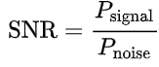
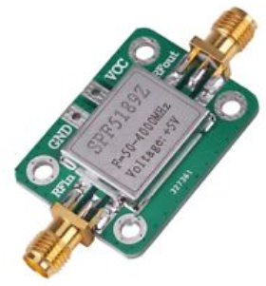
Application #2
Low-noise amplifiers (LNA)
Takes low powered signals and amplifies them without affecting signal-to-noise ratio
Signal-to-Noise Ratio (SNR)
Ratio of power of signal to power of noise
SHould be greater than 1:1
Used to amplify signal and reduce noise in the receiver
Placing LNA closer to signal source (top of antenna), reduces noise by the gain provided from LNA
CE configuration yields medium source impedance

Slide 7
Conclusion
The CE amplifier can be implemented in numerous applications
Most relevant application is in RF and wireless communication systems
Transistor amplifiers (CE, CS, CD, etc.) can be configured in different ways and each has a different application

Slide 8




THANK YOU!

